Slide 1

ASSIGNMENT 9
Multi-Antenna Modulation
Performance Analysis

Slide 2
Problem Statement
Evaluating wireless communication reliability requires analyzing Bit Error Rate (BER) under various channel conditions.
The Challenge:
•
How do higher-order modulations (QPSK, 16-QAM) perform in fading channels?
•
Quantifying the gain achieved by moving from SISO to diversity schemes like SIMO and MISO.
•
Assessing Spatial Multiplexing (MIMO) efficiency using Zero-Forcing receivers.

Slide 3
Objectives
2. Architecture Analysis
1. Performance Comparison
•
SISO: Baseline AWGN/Rayleigh.
•
Compare BPSK, QPSK, 4-QAM, 8-QAM, and 16-QAM.
•
SIMO (1x2): Receive Diversity (MRC).
•
Analyze BER vs SNR (0-30 dB) curves.
•
MISO (2x1): Transmit Diversity (Alamouti).
•
MIMO (2x2): V-BLAST with Zero-Forcing.

Slide 4


System Architecture Overview
SISO
SIMO (1x2)
MISO (2x1)
MIMO (2x2)
...
...
...
...
Single Path
Max Ratio Combining
Alamouti Coding
V-BLAST / ZF

Slide 5
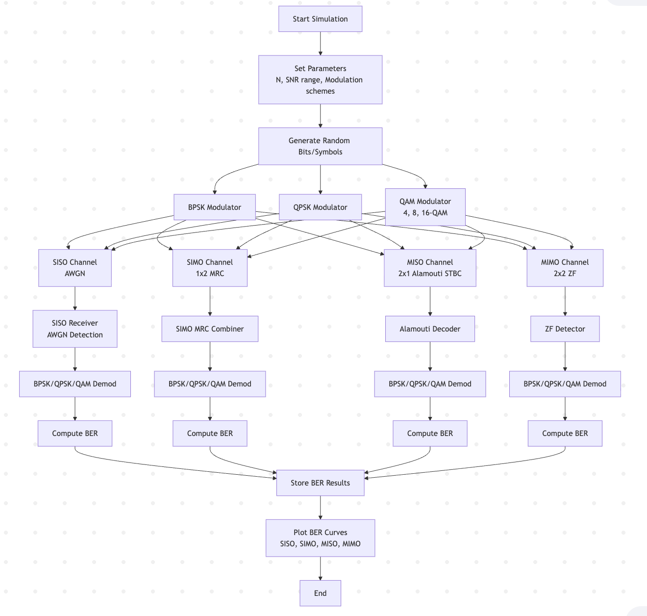


(DFD)
(Encoding -> Fading -> Decoding)

Slide 6
Pseudocode: SISO
Start
Set number of bits N
Define SNR range (in dB and linear)
Initialize BER arrays for all modulations
--- BPSK ---
Generate random bits
Map bits to BPSK symbols
For each SNR:
Add AWGN noise
Detect symbols
Compute BER
--- QPSK ---
Generate random symbols
Modulate using QPSK
For each SNR:
Add AWGN
Demodulate
Compute BER
--- 4-QAM, 8-QAM, 16-QAM ---
For each QAM order:
Generate random symbols
Modulate using QAM
For each SNR:
Add AWGN
Demodulate
Compute BER
Plot BER vs SNR for all modulation schemes
Use semilog plot
End
% MRC: Align phases and sum
END
Explanation
•
SISO: Standard AWGN channel simulation.
•
SIMO (1x2): Uses 2 receive antennas.
•
MRC Logic: The receiver multiplies the incoming signal by the conjugate of the channel estimate (h^*). This cancels out the phase error and constructively adds signal power.

Slide 7
Start
Set N, SNR range, number of Rx antennas = 2
Initialize BER arrays
Generate BPSK, QPSK, QAM symbols
For each SNR:
Generate channel h (2 x N)
Generate AWGN noise
--- BPSK ---
Receive: r = h*s + n
MRC combine: y = (hᴴ r) / (|h|²)
Detect BPSK bits
Compute BER
--- QPSK ---
Receive, combine same way
Demodulate
Compute BER
--- 16-QAM ---
Receive, combine
Demodulate
Compute BER
Plot BER vs SNR
End
Pseudocode — SIMO (1×2) Diversity

Slide 8
Pseudocode: MISO (Alamouti 2x1)
Start
Set N, SNR range, Tx=2, Rx=1
Initialize BER arrays
Generate BPSK, QPSK, QAM symbols
Group symbols into pairs (s1, s2) for Alamouti
For each SNR:
Generate channel h1, h2 (for two Tx antennas)
Generate AWGN noise n1, n2
--- BPSK ---
Apply Alamouti encoding & transmission
Form received signals r1, r2
Apply Alamouti combiner:
Compute y1 and y2 estimates
Detect bits, compute BER
--- QPSK ---
Same steps with QPSK demodulation
Compute BER
--- 16-QAM ---
Same steps with QAM demodulation
Compute BER
Plot BER vs SNR
End
Pseudocode — MISO (2×1) with Alamouti STBC
% Alamouti Decoding
% Normalize by channel power
END
Explanation
•
Alamouti Scheme: A clever technique to achieve transmit diversity without channel state information at the transmitter.
•
Orthogonality: The signals are sent such that they can be separated perfectly at the receiver using simple linear algebra.
•
Full Rate: Transmits 2 symbols in 2 time slots.

Slide 9
Pseudocode: MIMO (2x2 V-BLAST)
Start
Set N, SNR range, Tx=2, Rx=2
Reshape data into vectors of size Tx
Initialize BER arrays
Generate BPSK, QPSK, QAM symbols (mapped to 2 streams)
For each SNR:
For each symbol vector:
Generate channel matrix H (2×2)
Generate noise vector n
Transmit r = H*s + n
Apply Zero-Forcing:
W = (Hᴴ H)^(-1) Hᴴ
y = W r
Store detected symbols
Demodulate and compute BER for:
BPSK
QPSK
16-QAM
Plot SER/BER vs SNR
End
% Zero-Forcing (ZF) Equalizer
% W = pseudo_inverse(H)
% Symbol Estimation
END
Explanation
•
V-BLAST: Vertical-Bell Laboratories Layered Space-Time. Sends independent data streams on each antenna.
•
Zero-Forcing: The receiver inverts the channel matrix (H^-1) to separate the mixed signals.
•
Trade-off: Simple to implement but amplifies noise (Noise Enhancement).

Slide 10
Results & Conclusion
Key Findings
•
Modulation Order: BPSK requires the least SNR for a given BER, while 16-QAM requires the most. Higher rate = Higher error probability.
•
Diversity Gain:
•
SIMO (1x2): Significant improvement (~3dB gain) due to coherent combining.
•
MISO (2x1): Robust performance matching diversity order 2.
•
MIMO: V-BLAST increases data rate but ZF receiver suffers noise enhancement at low SNR.

Slide 11
